Slide 1
Artificial intelligence
Name:rawan khaled amin
Id: 322 group:3
Section:14 b.n:22

Slide 2
applications:
Astronomy
Healthcare
Transport
Agriculture
Education
E-Commerce
Entertainment
Robotics
Automotives
Social Media

Slide 3
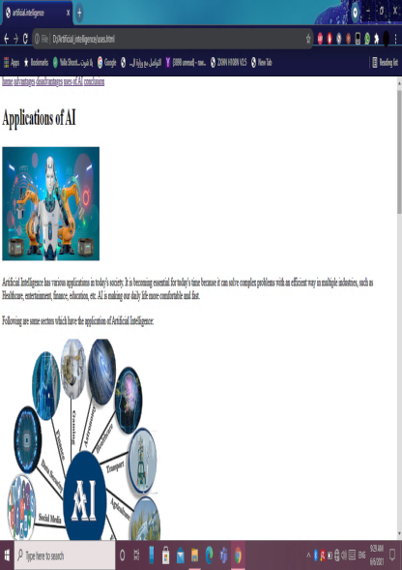
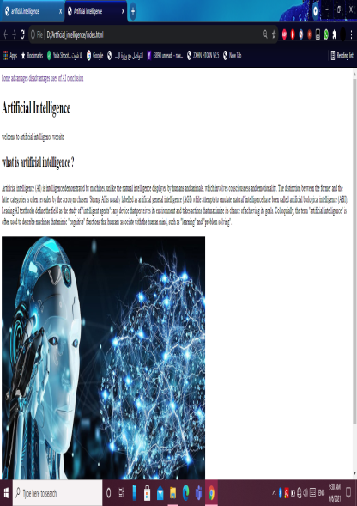
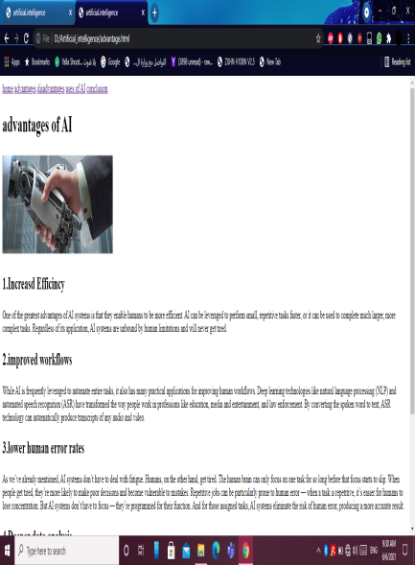
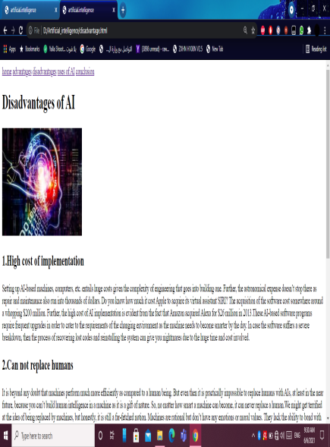
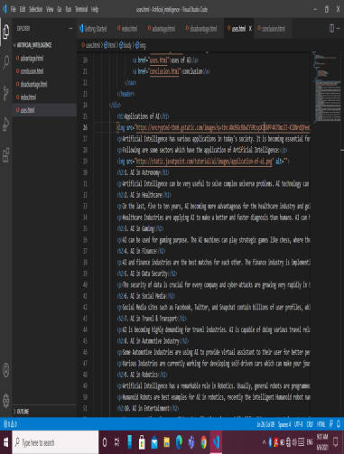

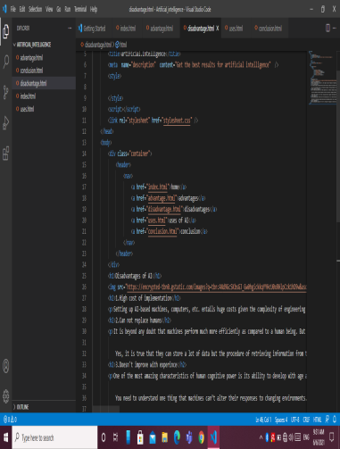
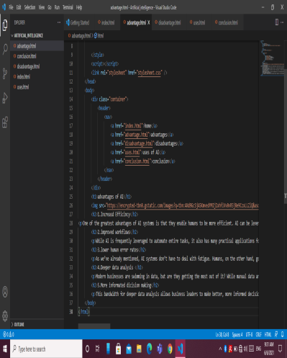
Source codes:

Slide 4
Links:

